Slide 1
Year 4 Statutory Multiplication Check 2025

Slide 2
Administering the test
The multiplication tables check (MTC) is statutory for all year 4 pupils.
In 2025, schools must administer the MTC to all eligible year 4 pupils between Monday 2 June and Friday 13 June.
The purpose of the MTC is to determine whether pupils can recall their times tables fluently, which is essential for future success in mathematics. It will help schools to identify pupils who have not yet mastered their times tables, so that additional support can be provided.
Schools must provide a reason within the MTC service for any pupils who are not able to participate in the check.

Slide 3
Administering practice tests: April 2025
Schools can access the MTC service to prepare for the check via DfE Sign-in from Monday 28 April.
These sessions allow children to practice on the device, (iPad/ laptop) and get used to where the buttons are/ how to enter and move onto the next question.
Children cannot go back and change a question- this is why it is important for them to be able to recall/ input their answer within the 6 second window.

Slide 4
How the check looks
Remaining time

Slide 5
Practicing at home and in school
Game format
When pupils play Soundcheck, they are asked 25 questions, each with a 6-second time limit. The questions are multiplication only and evenly weighted in terms of difficulty each time they play - exactly the same as the MTC.
Homework has been set for Soundcheck this term, with 5 games per session. This needs to be completed before children can access Garage or Studio.

Slide 6
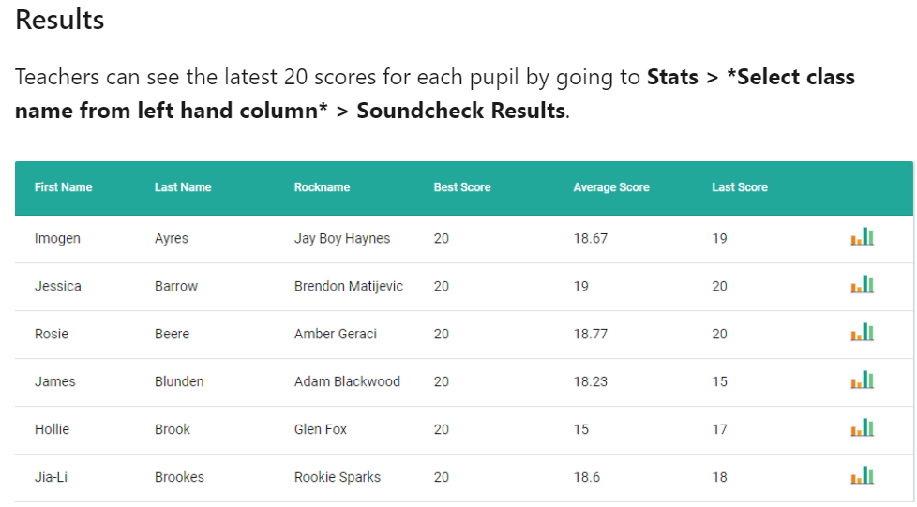
Results/ monitoring progress

Slide 7
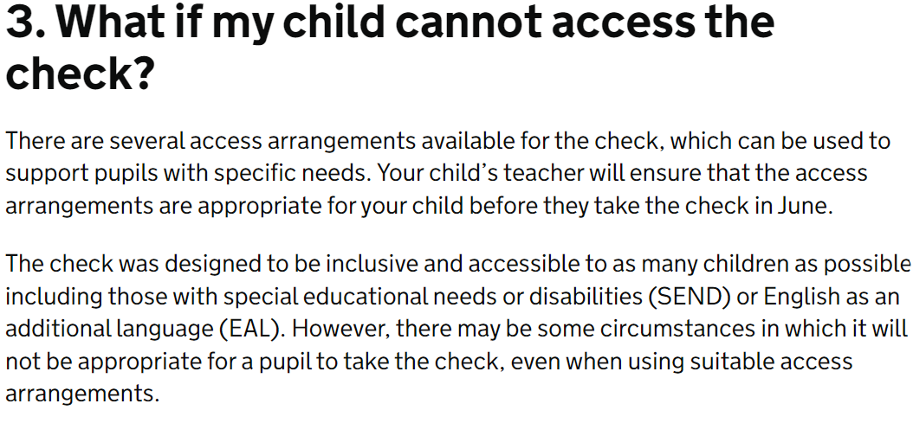
Access arrangements

