Slide 1

Year 6 Residential
4th – 6th March 2026

Slide 2

Wednesday 4th March
7.30am
Travel via the M62 down the M1
A distance of over 200 miles

Slide 3
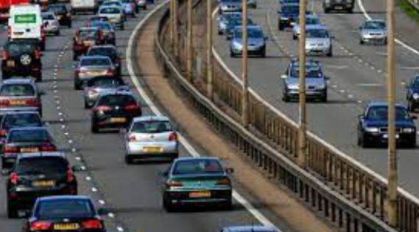
Bring a packed breakfast, snacks and lunch including drinks
It’s a long way!
We will stop at a service station for you to eat your mid-day snack

Slide 4
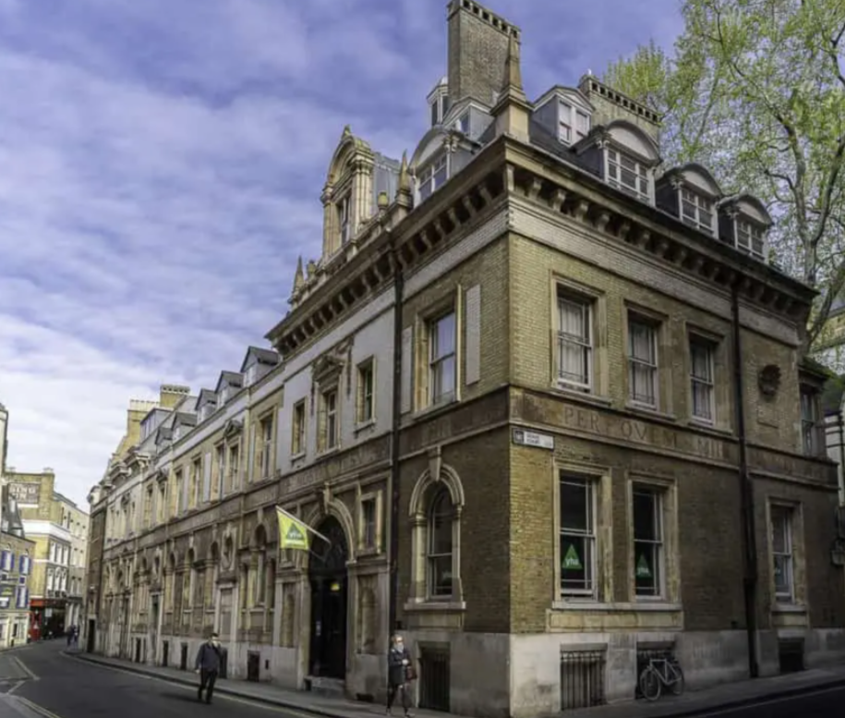
St.Paul’s Youth Hostel London

Slide 5
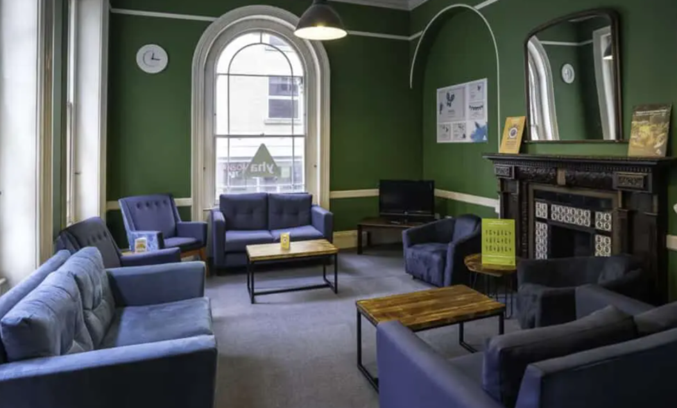
The Lounge

Slide 6
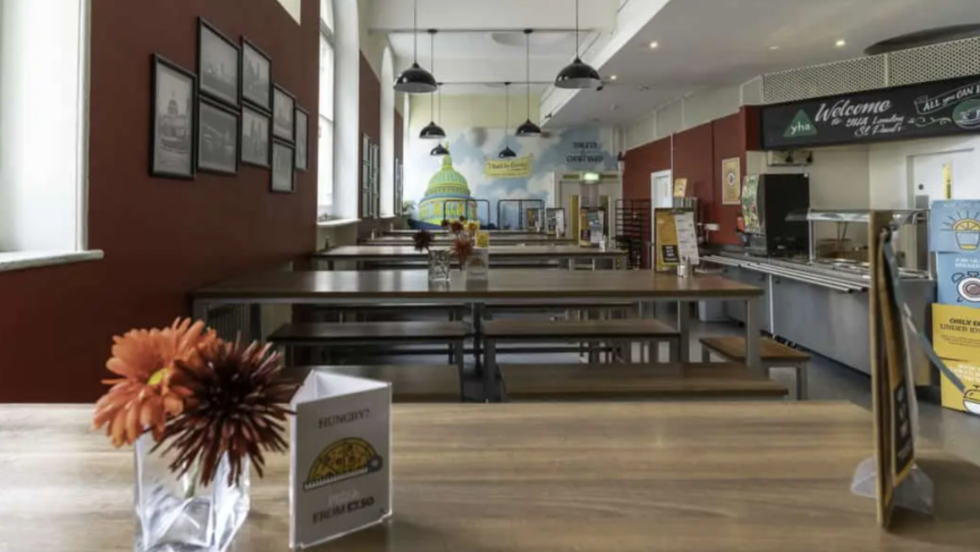
Dining Room

Slide 7
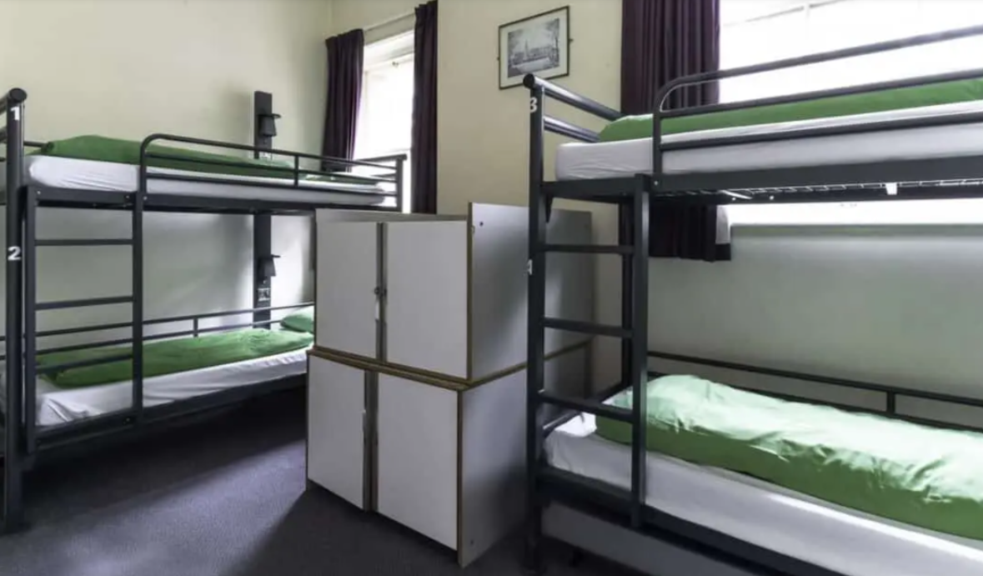
Dormitories

Slide 8
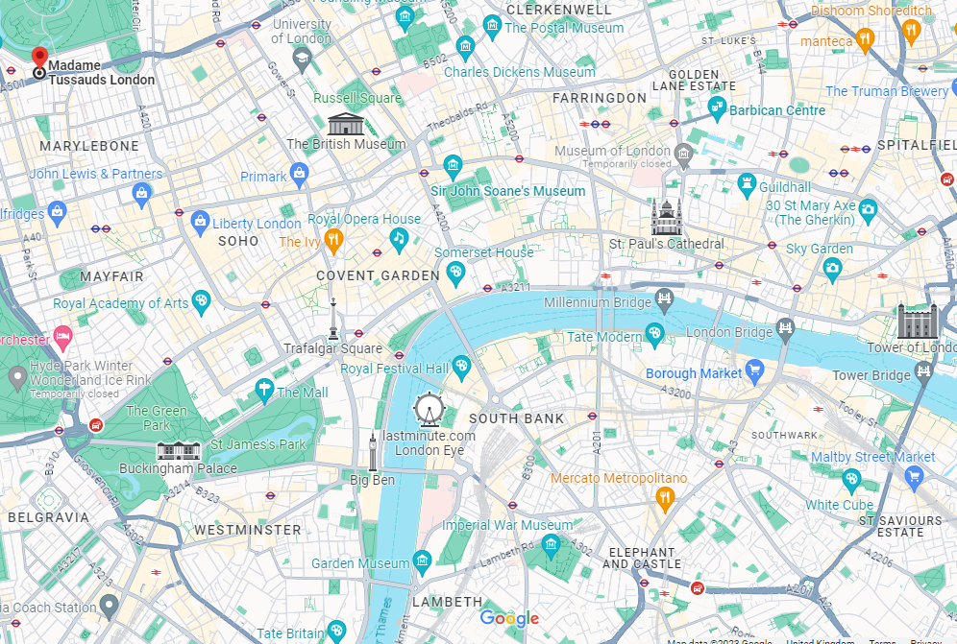

Slide 9
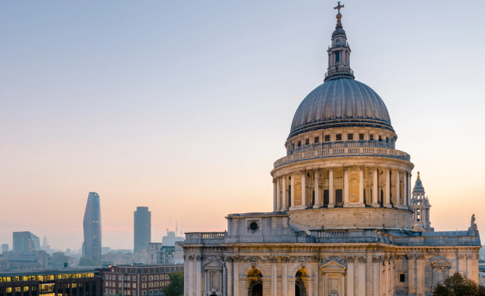
ST. PAUL’S CATHEDRAL

Slide 10
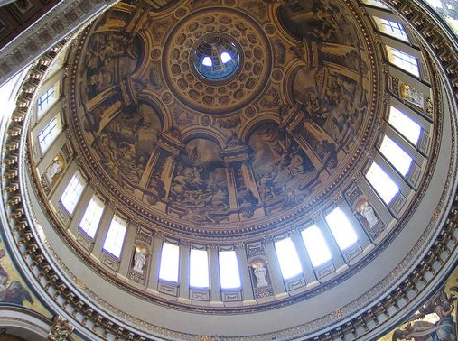
The Whispering Gallery

Slide 11
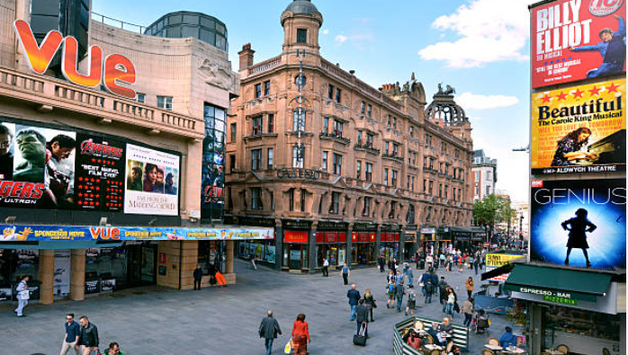
Leicester Square

Slide 12
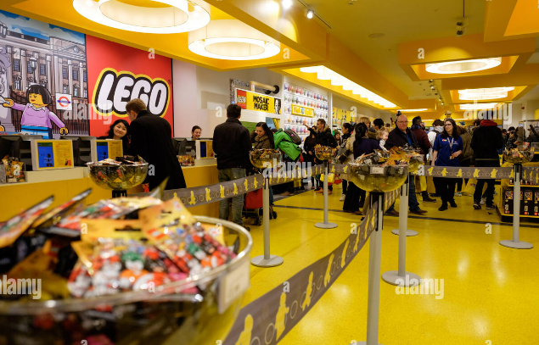
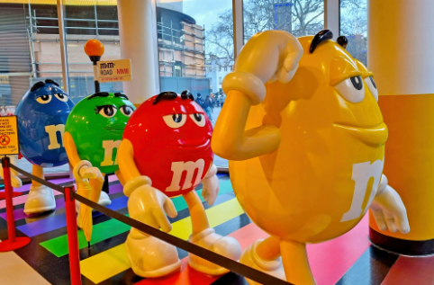

Slide 13
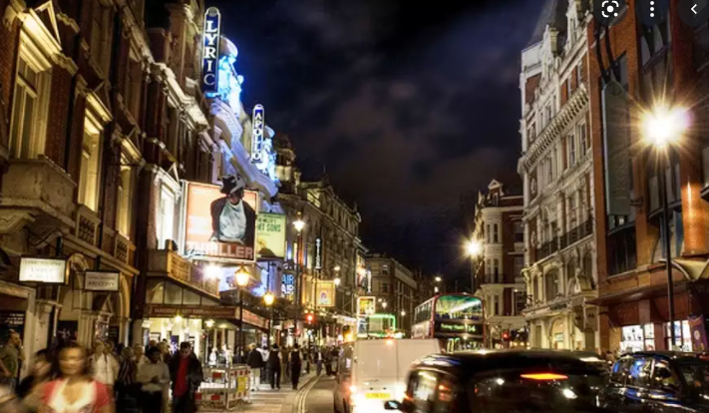
An evening in the
West End at the theatre

Slide 14
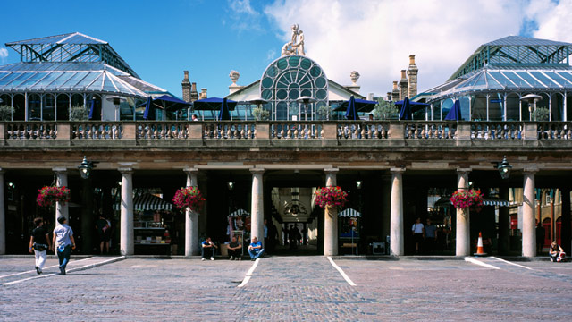

Slide 15
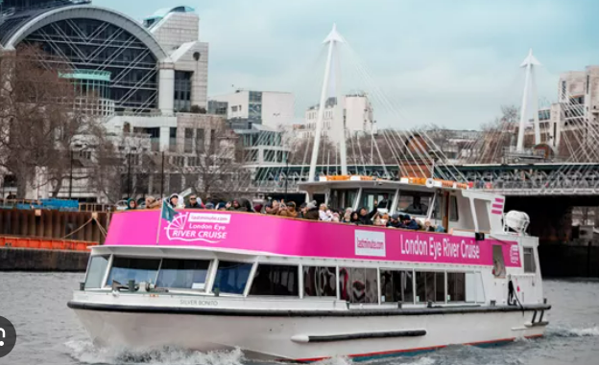
River Cruise

Slide 16
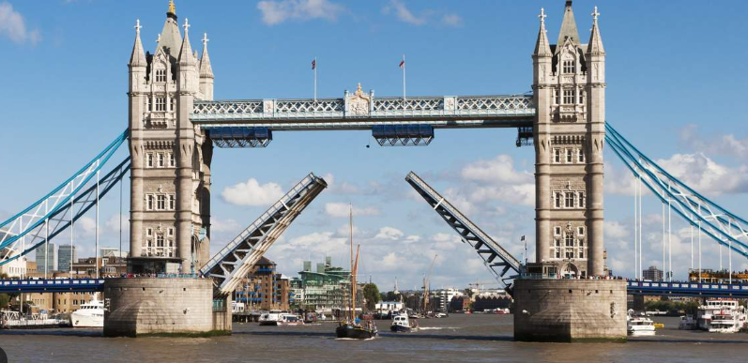
TOWER BRIDGE

Slide 17
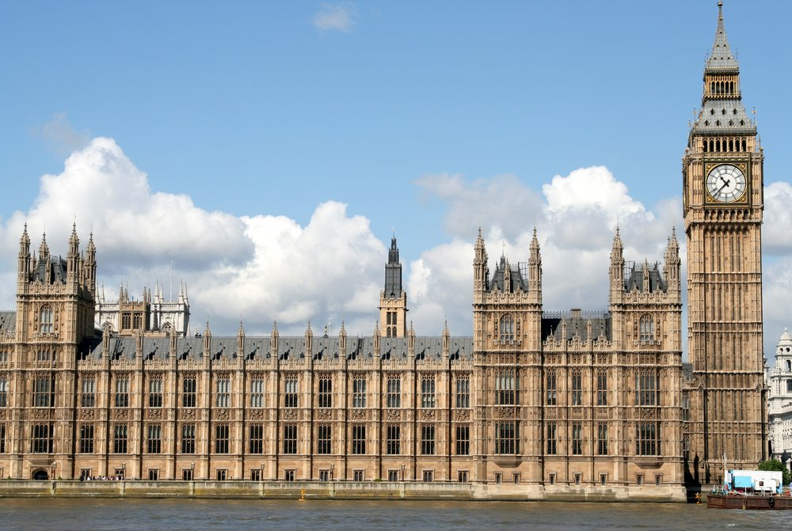
THE HOUSES OF PARLIAMENT

Slide 18
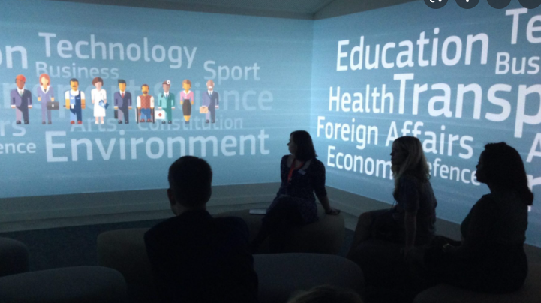
A workshop at the Houses of Parliament Education Centre
followed by a tour of the magnificent British Parliament

Slide 19
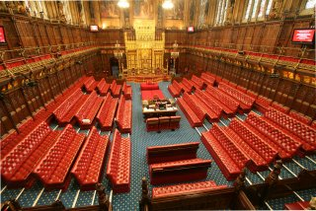
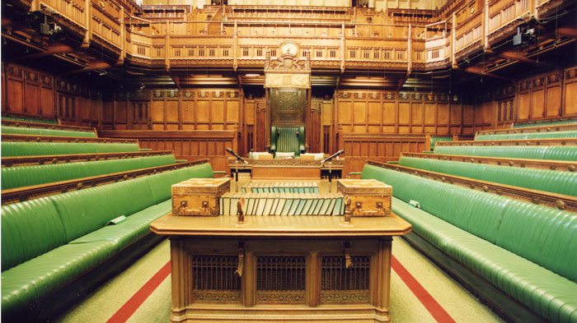
The House of Lords
The House of Commons

Slide 20
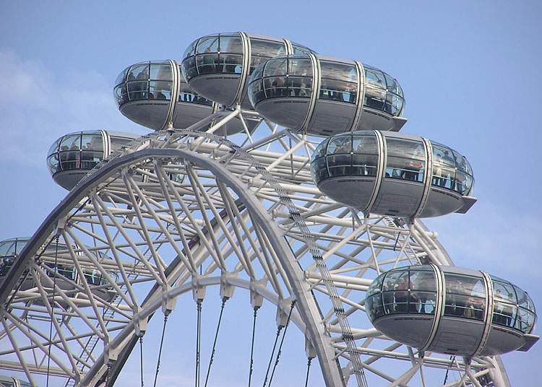
THE EYE

Slide 21
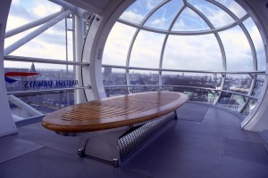
INSIDE ONE OF THE CAPSULES

Slide 22
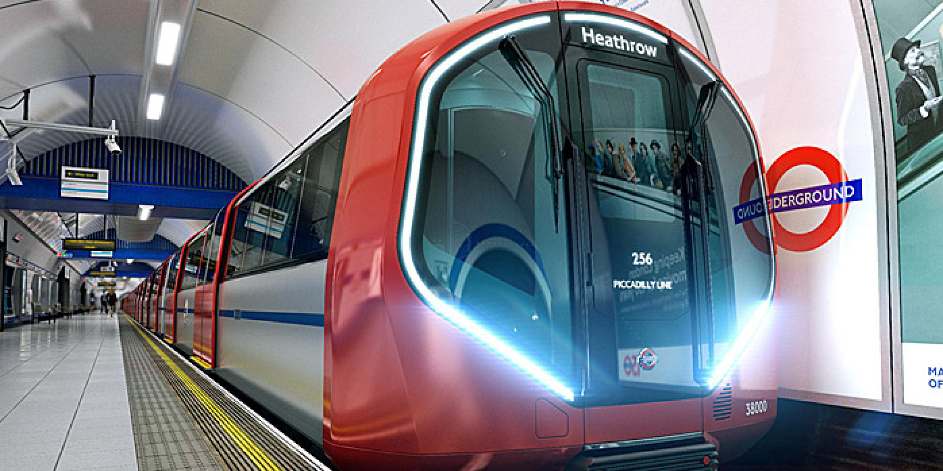
Whilst in London, we will travel on the London Underground.
The children will become familiar with the map and procedures of travelling on this systems prior to the residential.
Children will be in groups of 5 to one adult.

Slide 23
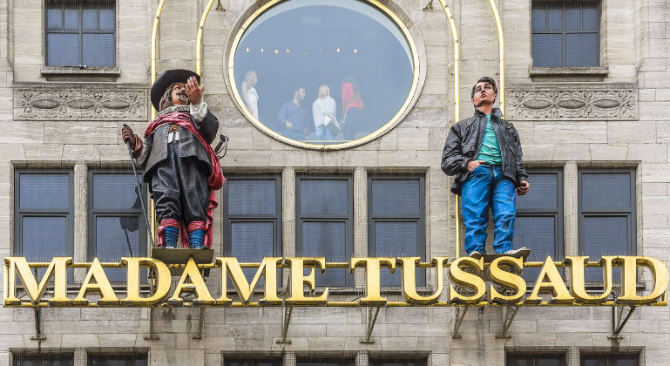

Slide 24
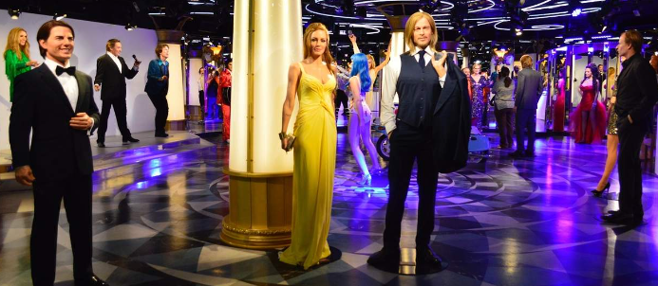
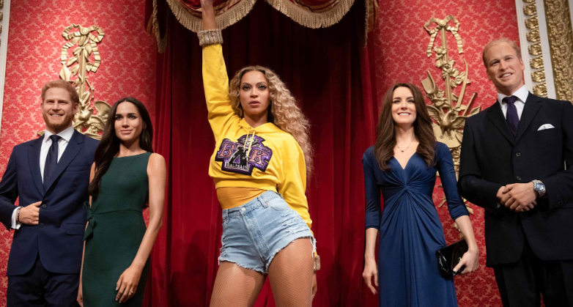
Madame Tussauds Waxworks

Slide 25
Return to school for approximately 6pm on Friday 6th March

Slide 26
£280
A non-returnable deposit of £70 by 3rd November

Slide 27
Payment plan:
A further 3 payments of £70 due:
5th Dec
5th Jan
5th Feb

