Slide 1

KS1 Phonics
Screening Check
19.3.25

Slide 2
What is phonics?
Children are taught to read by breaking down words into separate sounds or ‘phonemes’. They are then taught how to blend these sounds together to read the whole word.
Children have a 30 minute phonics lesson each day and they are encouraged to use these strategies to read and write in other lessons.
There are 40+ different sounds.

Slide 3
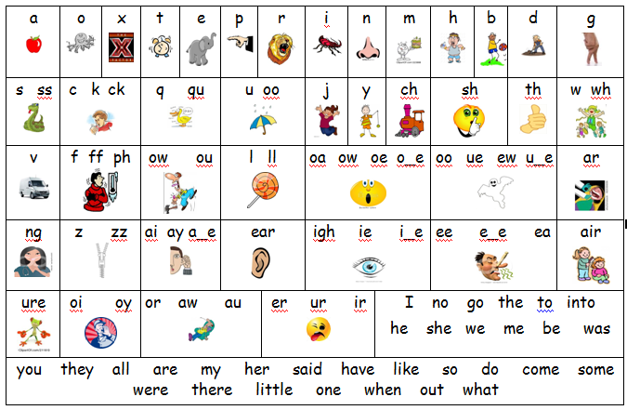

Slide 4
WHAT IS THE YEAR 1 PHONICS SCREENING CHECK?
The phonics screening check will be taken individually by all children in Year 1 in England – this began in June 2012.
It is designed to give teachers and parents information on how your child is progressing in phonics.
It will help to identify whether your child needs additional support at this ‘midpoint’ stage so that they do not fall behind in this vital early reading skill.

Slide 5
HOW IS THE PHONICS SCREENING CHECK COMPLETED?
The check is very similar to tasks the children already complete during phonics lessons.
There are two sections in the 40-word check and it will assess phonics skills and knowledge learned through Reception and Year 1.
20 real words and 20 nonsense words.
It usually takes around 5-10 minutes to complete.
Children will be asked to ‘say the sounds and read the word’. E.g. d-o-g – dog.

Slide 6
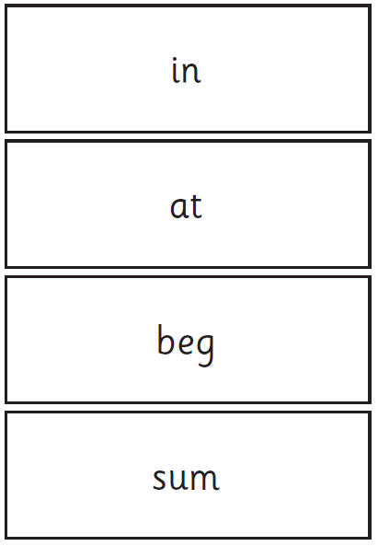
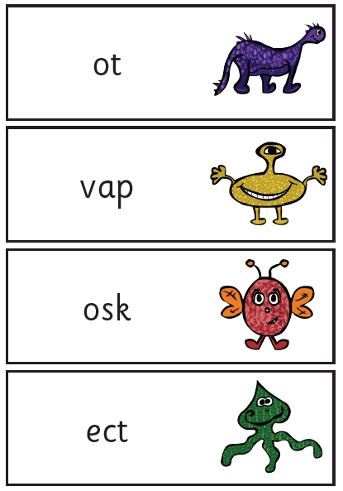
WHAT WILL IT CHECK?
It will check that your child can:
Sound out and blend graphemes in order to read simple words.
Read phonically decodable one-syllable and two-syllable words, e.g. cat, sand, windmill.
Read a selection of nonsense words which are referred to as pseudo words.

Slide 7
WHAT ARE NONSENSE, PSEUDO OR ALIEN WORDS AND WHY ARE THEY INCLUDED?
These are words that are phonically decodable but are not actual words with an associated meaning e.g. brip, snorb. Pseudo words are included in the check specifically to assess whether your child can decode a word using phonics skills and not their memory.

Slide 8
WHAT SORT OF CHECK IS IT AND IS IT COMPULSORY?
It is a school-based check to make sure that your child receives any additional support promptly, should they need it.
It is not a stressful situation as the teacher will be well-equipped to listen and understand your child’s level of skills.
There will be a few practice words first to make sure your child understands the activity. We have also regularly completed past papers – it will in no way be new to your child.

Slide 9
IS THERE A PASS MARK?
Historically the pass mark has been 32 out of 40. However, if children do not reach the required standard, tailored support will be set up to ensure that your child can catch up.
Children progress at different speeds so not reaching the score does not necessarily mean there is a problem.
If they don’t pass in Year 1 your child will re-sit the check the following summer term in Year 2.

Slide 10
WHEN WILL THE
SCREENING TAKE PLACE?
Every child in the country will be completing the phonics screening check the week beginning 9th June.
It is very important your child is in school during this week.
We will report back your child’s score to you through your child’s end of term report.

Slide 11
HOW CAN I HELP
Digraph- 2 letters making one sound = cow
Trigraphs- 3 letters making one sound = night
Split digraphs- 2 vowels with a consonant in between. Use to be known as the magic e!
spine - i_e
Encourage your child to ‘sound out’ when reading or writing. Focus particularly on spotting more unusual sound patterns.

Slide 12
HOW CAN I HELP
You can also try using:
Phonics screening past paper – available to download for free
and
Phonics Play - ‘BURIED TREASURE’ - Free internet activity

Slide 13
PLEASE REMEMBER
Phonics is not the only thing needed to become a fluent reader. Please continue to read with your child each night and encourage them to:
Sound out.
Re-read to check it makes sense.
Use pictures for clues.
Ask questions about the book.
And most importantly ENJOY READING!

Slide 14
QUESTIONS?

