Slide 1

A CAPITAL ADVENTURE FOR OUR YEAR 6 CHILDREN!

Slide 2
Year 6 Residential
10th March – 12th March 2027

Slide 3
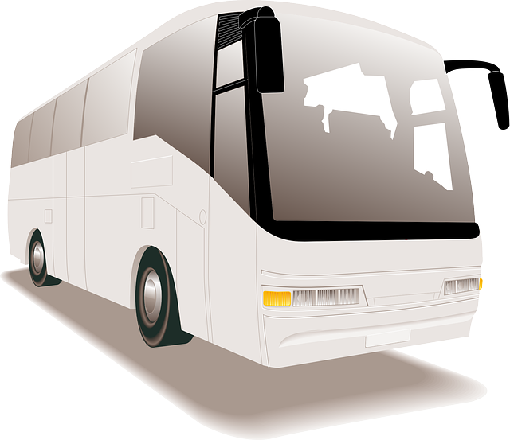
Wednesday 10th March
7.30am
Travel via the M62 down the M1
A distance of over 200 miles

Slide 4
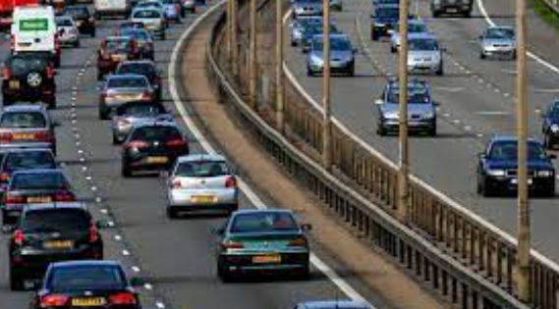
Bring a packed breakfast, snacks and lunch including drinks
It’s a long way!
We will stop at a service station for you to eat your mid-day snack

Slide 5
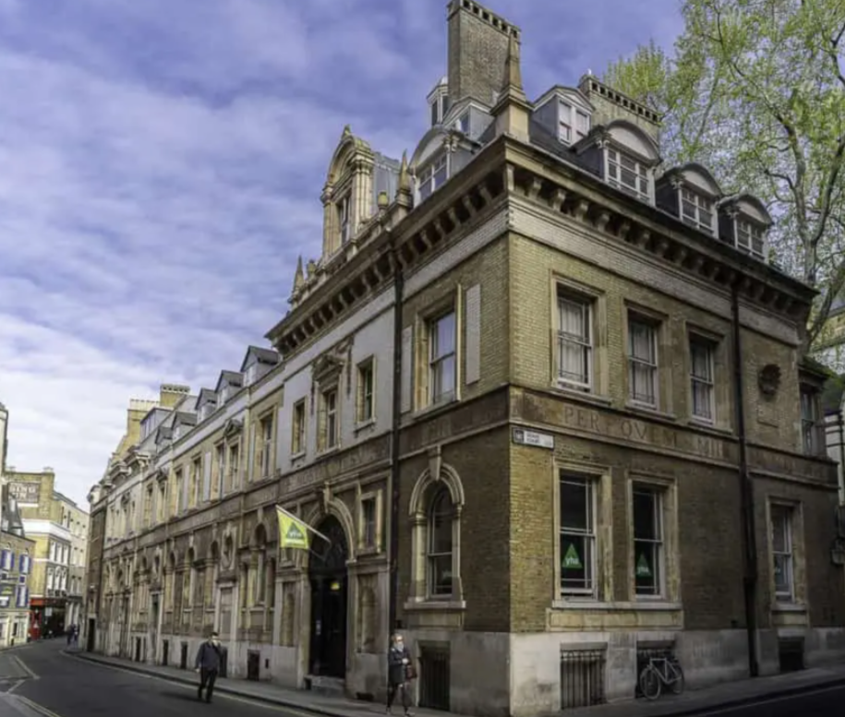
St.Paul’s Youth Hostel London

Slide 6
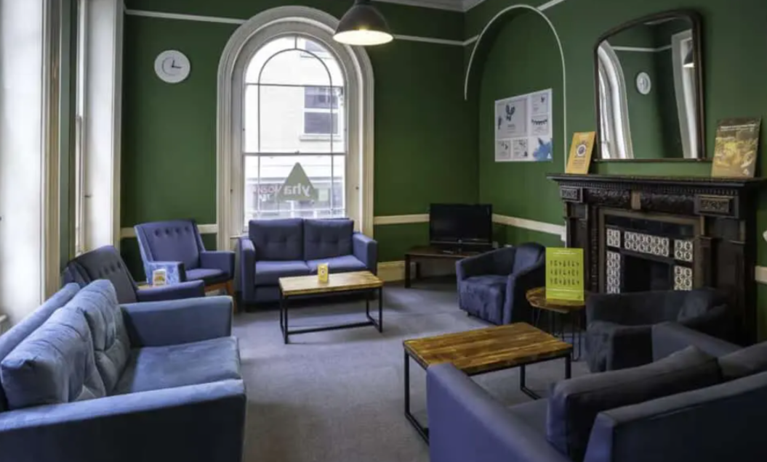
The Lounge

Slide 7
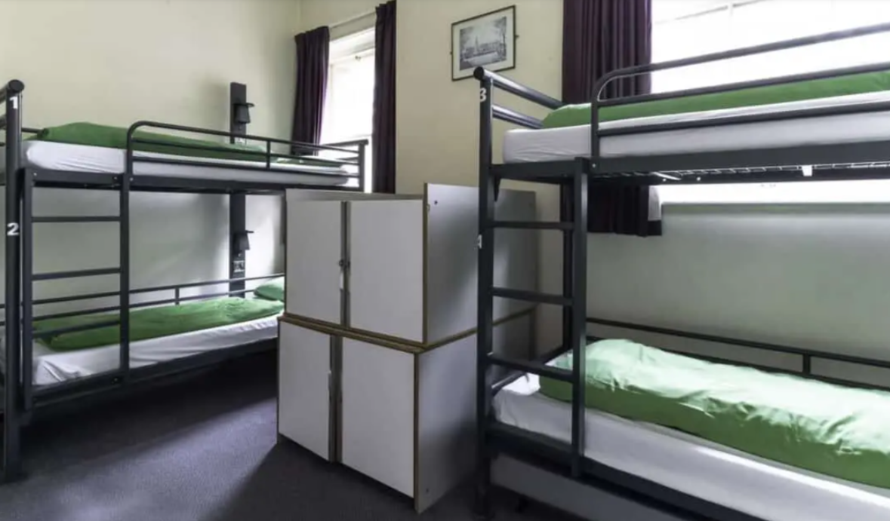
Dormitories

Slide 8
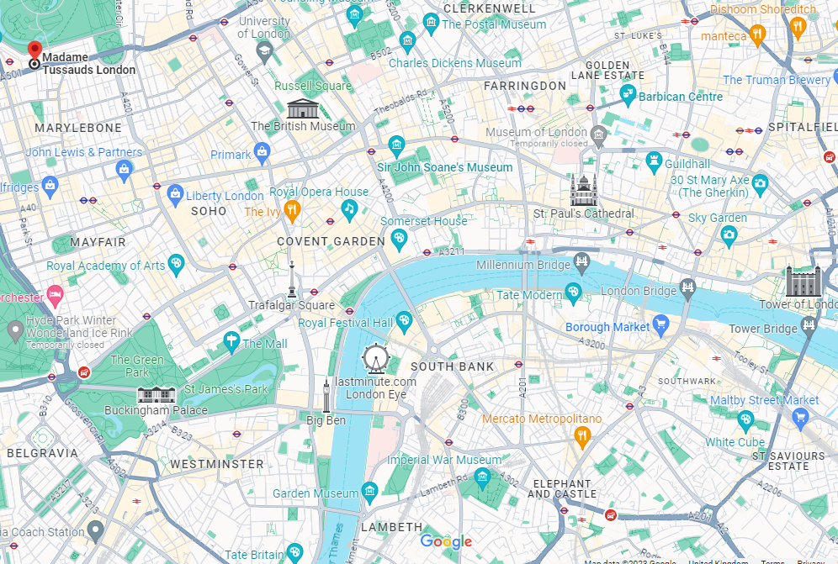

Slide 9
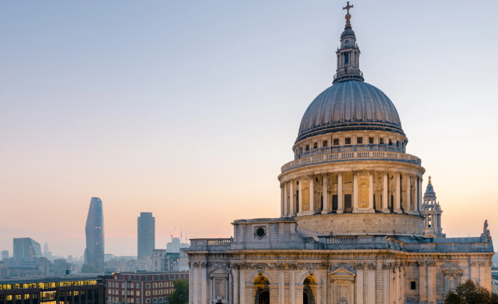
ST. PAUL’S CATHEDRAL

Slide 10
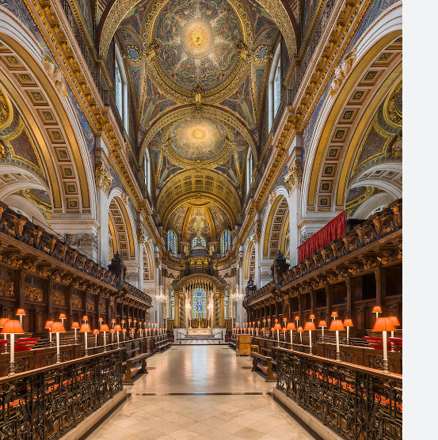

Slide 11
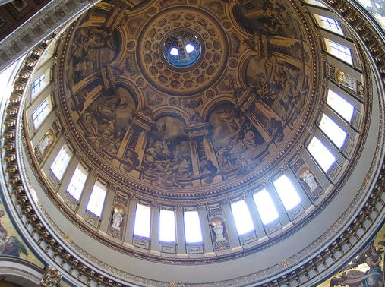
The Whispering Gallery

Slide 12
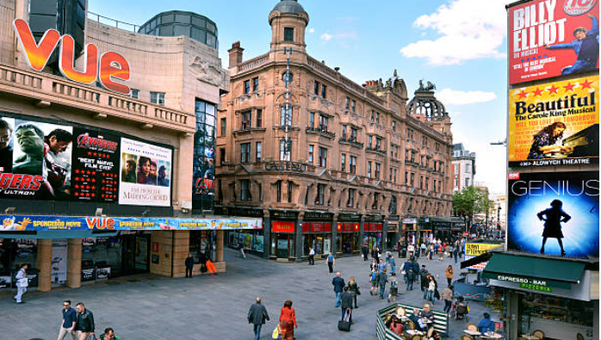
Leicester Square

Slide 13
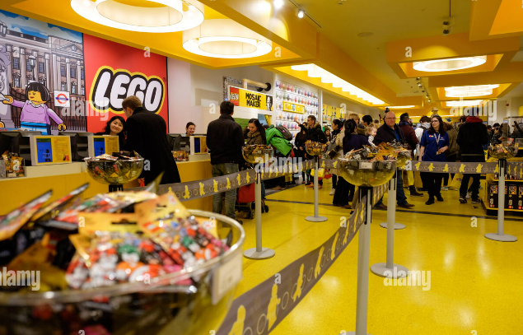
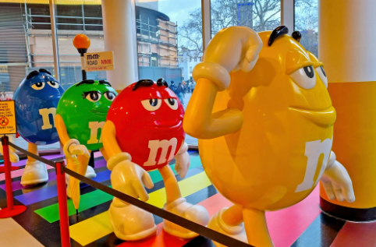

Slide 14
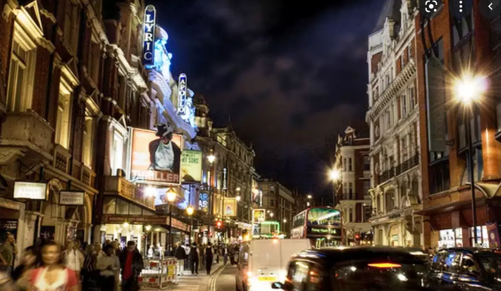
An evening in the
West End at the theatre

Slide 15

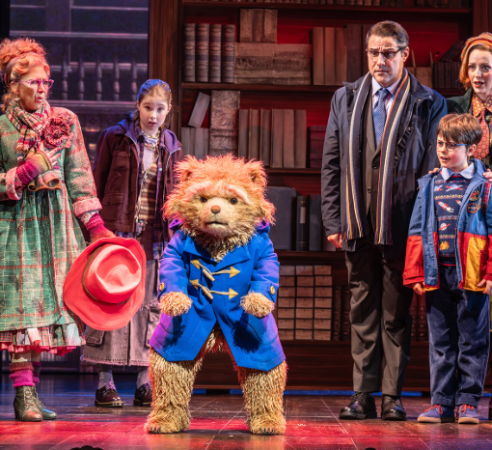

Slide 16
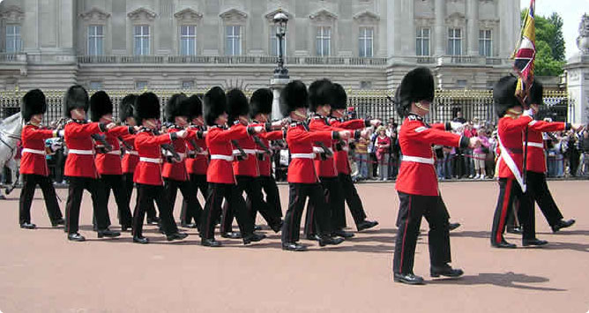

Slide 17
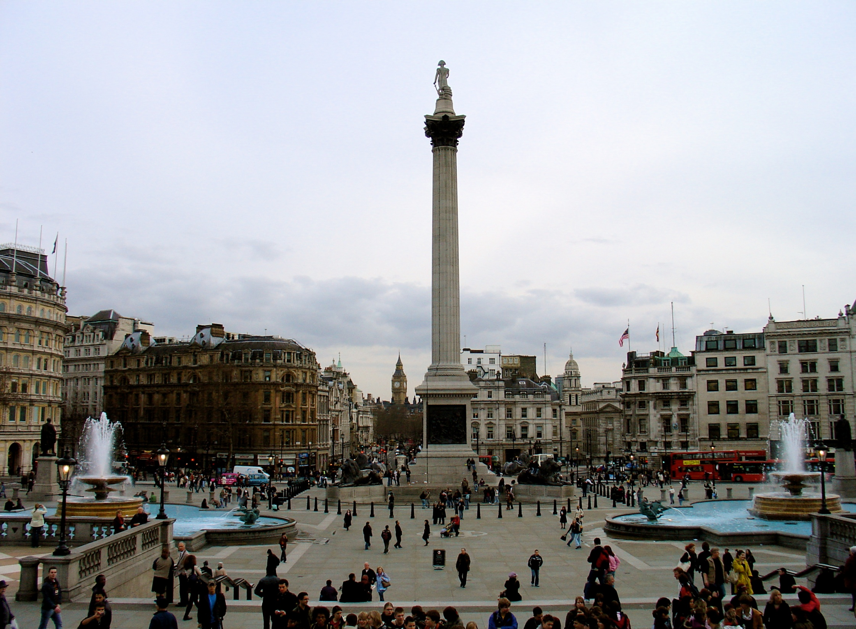

Slide 18
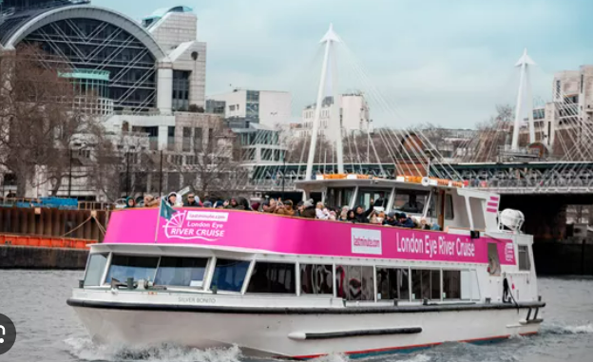
River Cruise

Slide 19
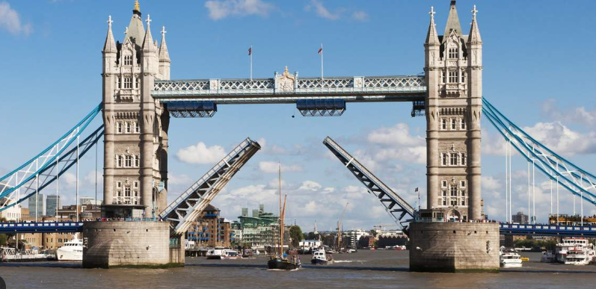
TOWER BRIDGE

Slide 20
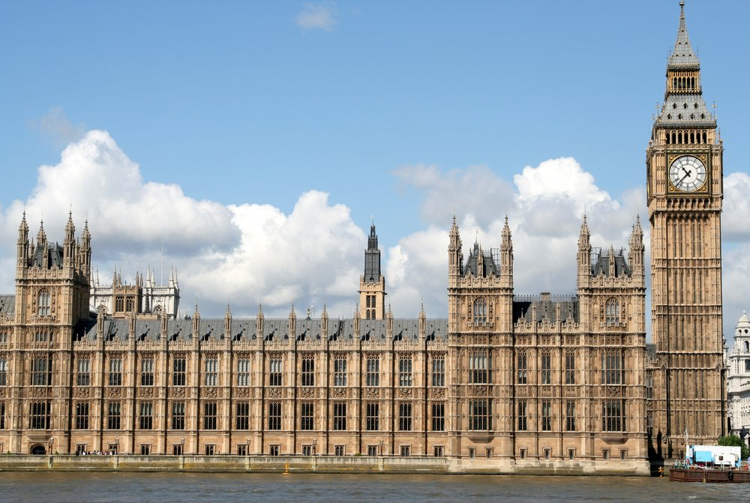
THE HOUSES OF PARLIAMENT

Slide 21
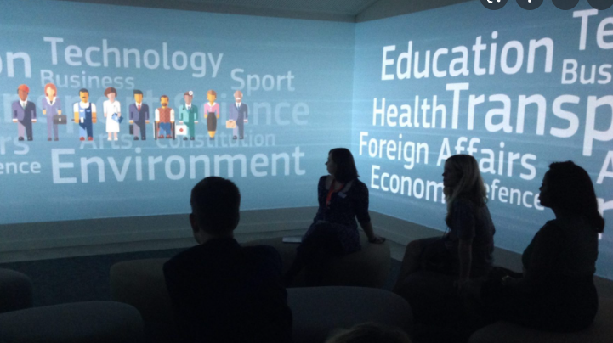
A workshop at the Houses of Parliament Education Centre
followed by a tour of the magnificent British Parliament

Slide 22
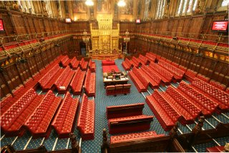
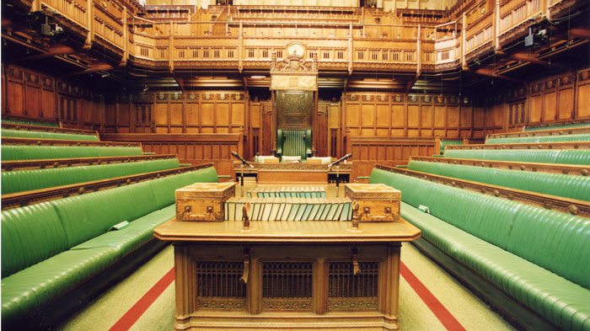
The House of Lords
The House of Commons

Slide 23
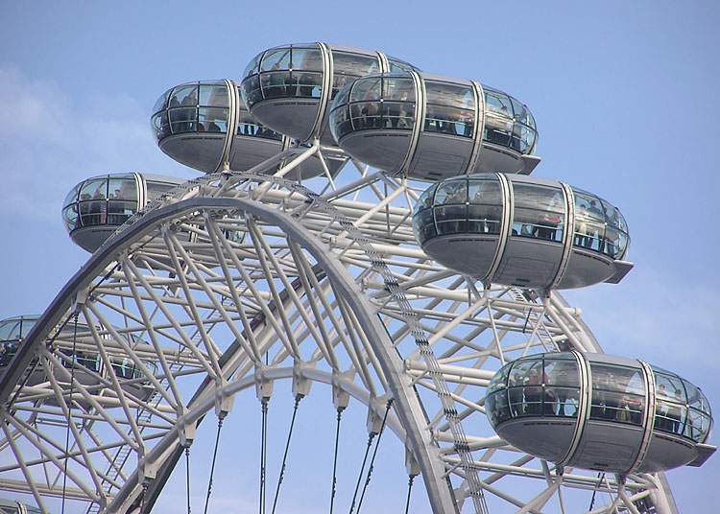
THE EYE

Slide 24
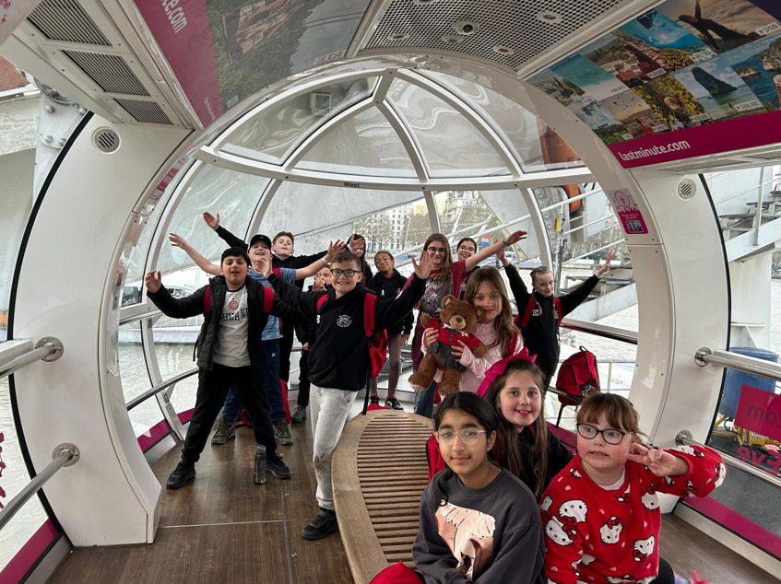
INSIDE ONE OF THE CAPSULES

Slide 25
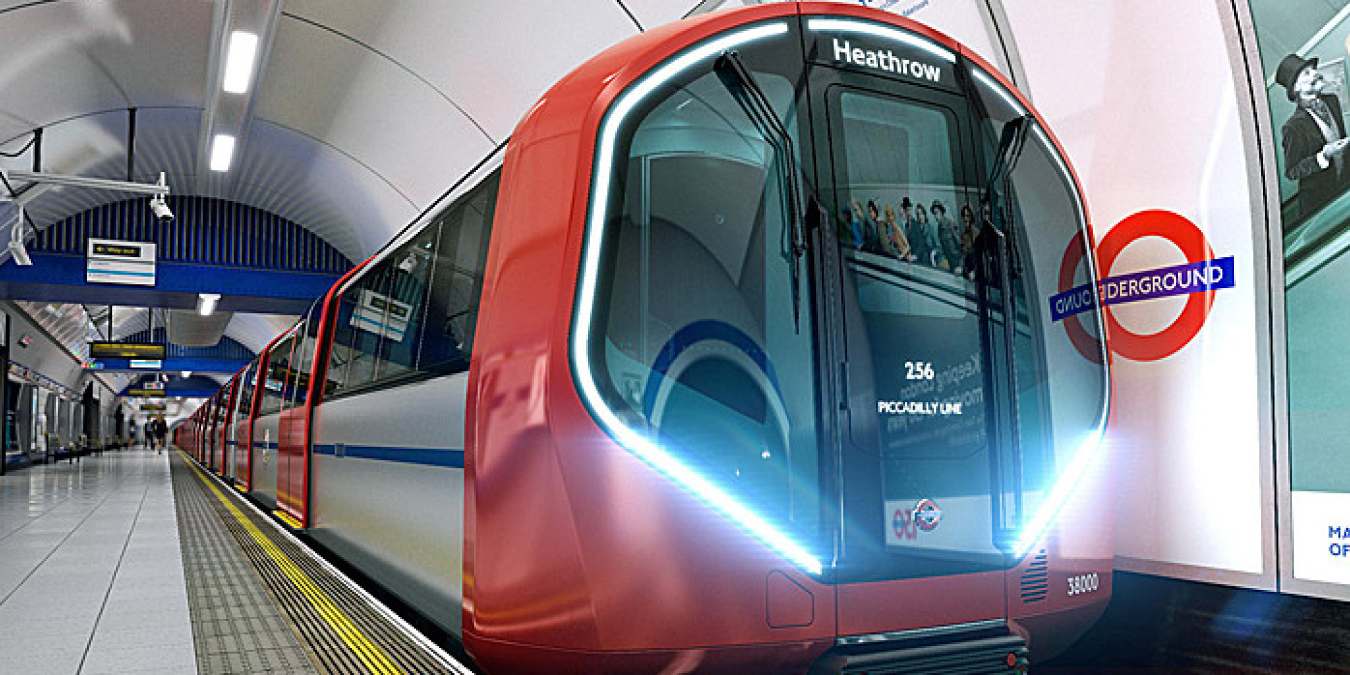
Whilst in London, we will travel on the London Underground.
The children will become familiar with the map and procedures of travelling on this systems prior to the residential.
Children will be in groups of 5 to one adult.

Slide 26
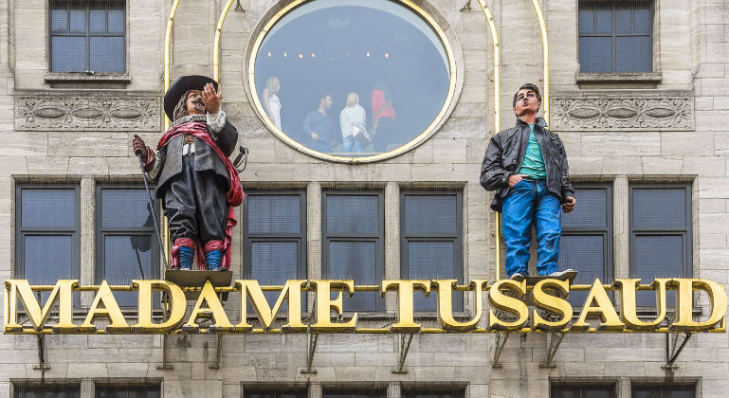

Slide 27
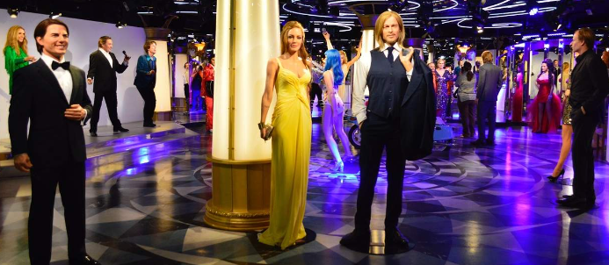
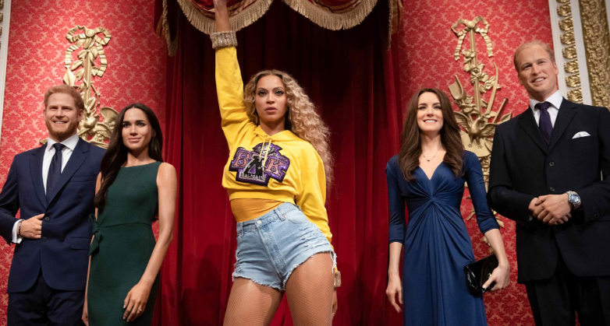
Madame Tussauds Waxworks

Slide 28
Return to school for approximately 6pm on Friday 12th March

Slide 29
£300
A non-returnable deposit of £60 by 1st October

Slide 30
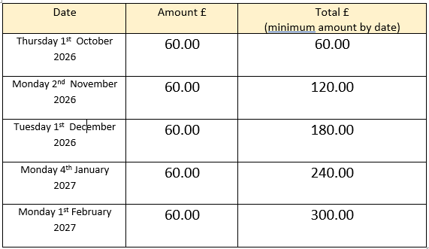
Payment plan:

